Slide 1

Vehicle Fuel Consumption Prediction Model
Prepared By: Kam Say Hong
Supervisor : Chong Yung Wey
Mentor : Gooi Liang Zheng
Host : White Room Analytics

Slide 2

Outline
Problem Statement
Goals and Objectives
Benefits of the project
Main challenges of this project
Research Methodology
Result
Contribution and Future Works

Slide 3
Problem Statement
Transportation emits most Co2 in Malaysia
OBD sensor data requires extensive preprocessing and cleaning before we can make use of those data

Slide 4
Goals and Objectives
Our goal is to clean OBD sensor data and produce a regression model that is able to forecast amount of vehicle fuel consumption given input of vehicle types, geographical data, engine condition, fuel level and driving behavior.
Objectives:
To conduct data exploration to extract insights, patterns, and relationships from the dataset.
To evaluate the factors affecting vehicle fuel consumption.
To generate a prediction model of fuel consumption for better accuracy.

Slide 5

Benefits of the project
route optimization
CO2 emissions estimation

Slide 6
Our main challenges : OBD data
often noisy, incomplete, and may contain outliers, making it difficult to extract useful information from it
the data may be collected from different sources, with different sampling rates and formats, adding to the complexity of processing and analyzing the data

Slide 7
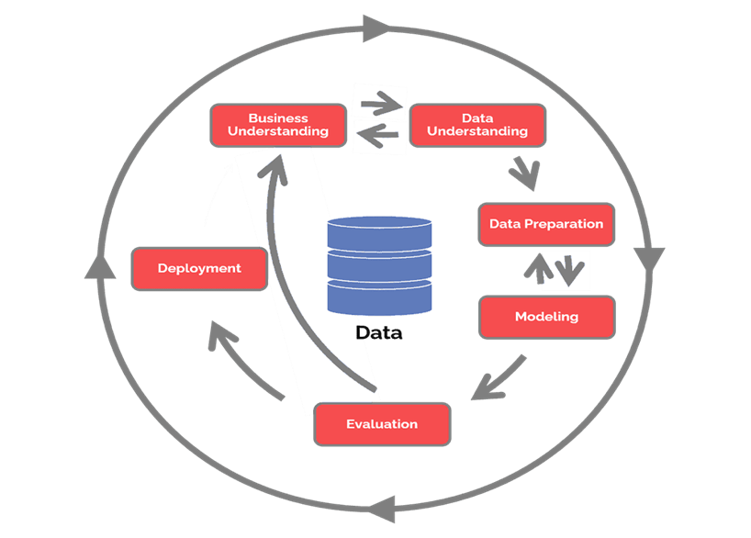
RESEARCH METHODOLOGY

Slide 8
Business Understanding
1. How to clean the OBD sensor data?
2. What are the factors affecting fuel consumption?
3. Can fuel consumption be predicted based with reasonable accuracy?

Slide 9
Data Understanding
Item | Description
Raw format of data | Json
Location of data | AWS S3
Size of data | About 11 million rows
Raw Attributes | 45 attributes with 7 derived attributes
Number of vehicles | 33
Number of trips | 33
Time range of data | 1 January 2022 to 12 May 2023

Slide 10
Attributes

Slide 11
Vehicle info
Fuel data
Gps data
Driving behaviour
Vehicle status
Sensor data
Speed data
Time data
misc
Vid
BDM
BTM
Engine cc
brand
model
Fuel capacity
Fuel
Fuel level
Fuel diff
Label
gnssStatus
Digital_ Output_1
iButton
LAC
gpsStatus
gnssHDOP
gnssPDOP
Altitude
location
Lat
Lon
distance
totalOdometer
Axis X
Axis Y
Axis Z
Heading
Battery Voltage
Battery Current
External voltage
Is Moving
Sleep mode
Engine Status
Analog Input 1
Analog Input 2
ICCID1
ICCID2
Gsm signal
MNC_MCC
connectivity
Digital Input 1
Speed generated
Speed
Created at
Device package time
Device time
Updated GPS At
Date
Time stamp
Device Package
Green driving type
Green driving value
misc

Slide 12
Vehicle info
Fuel data
Gps data
Driving behaviour
Vehicle status
Sensor data
Speed data
Time data
misc
Vid
BDM
BTM
Engine cc
Fuel capacity
Fuel
Fuel level
Fuel diff
Label
gnssHDOP
gnssPDOP
Altitude
Lat
Lon
distance
Axis X
Axis Y
Axis Z
Heading
Battery Voltage
Engine Status
Speed generated
Time stamp

Slide 13
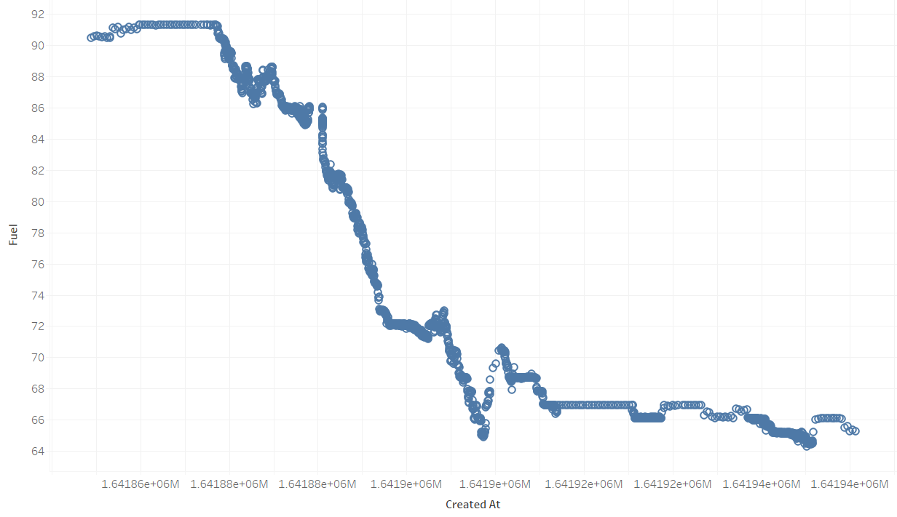
Assessing Data Quality – Fuel

Slide 14
Problem in fuel data (Tian et al., 2018)
Refueling
Fuel spilling or gasoline theft
Errors of fuel level sensor or wireless vehicular network transmission
Large shake of vehicle

Slide 15
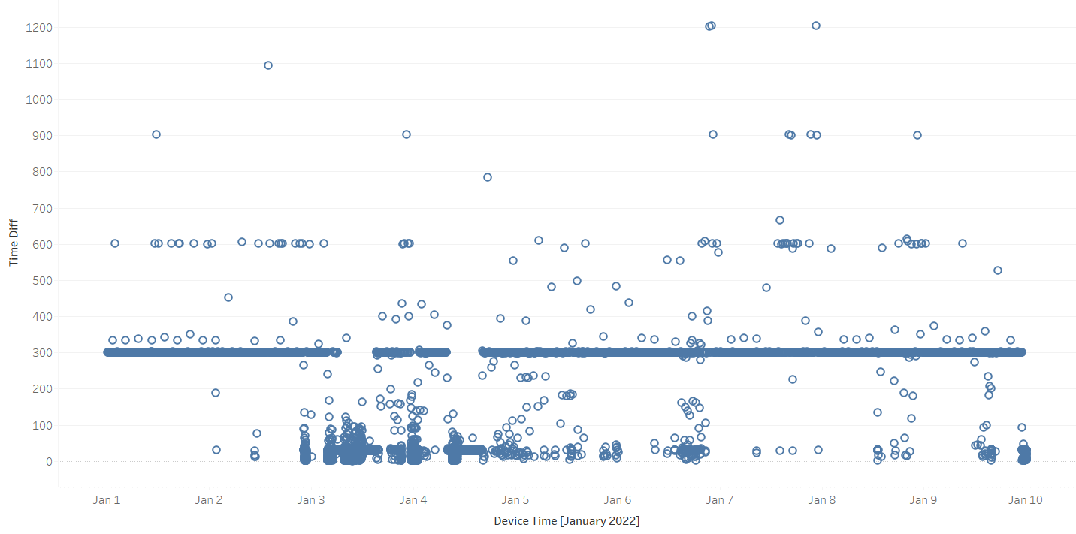
Assessing Data Quality – Time stamp interval

Slide 16
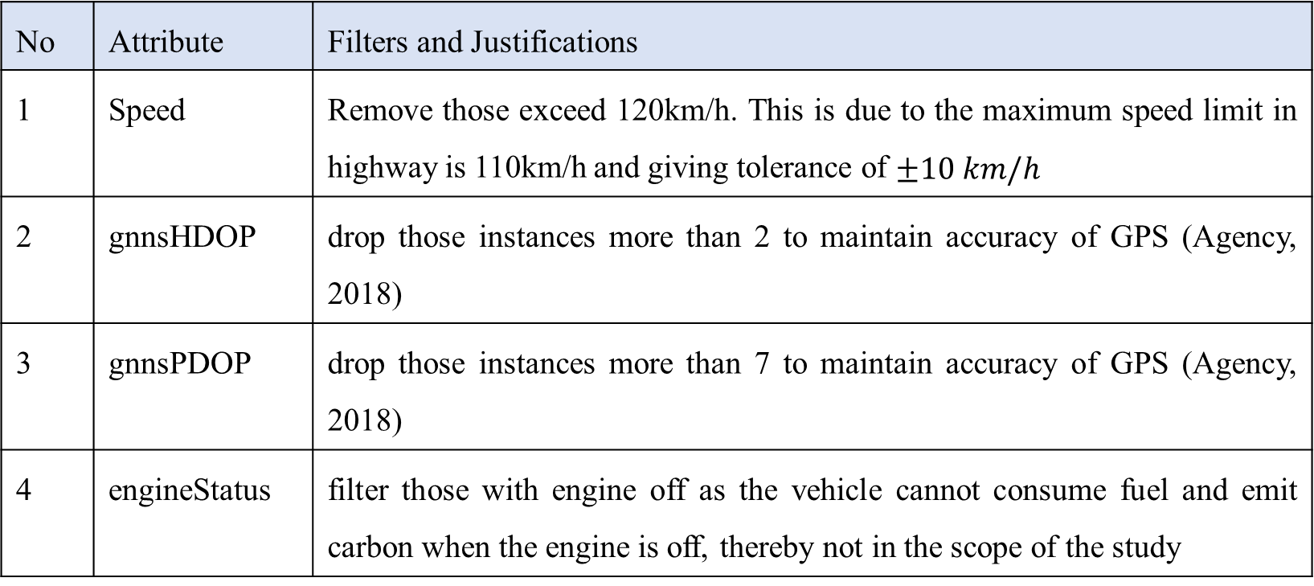
Data Cleaning – Filtering
No | Attribute | Filters and Justifications
1 | Speed | Remove those exceed 120km/h. This is due to the maximum speed limit in highway is 110km/h and giving tolerance of $±10 km/h$
2 | gnnsHDOP | drop those instances more than 2 to maintain accuracy of GPS (Agency, 2018)
3 | gnnsPDOP | drop those instances more than 7 to maintain accuracy of GPS (Agency, 2018)
4 | engineStatus | filter those with engine off as the vehicle cannot consume fuel and emit carbon when the engine is off, thereby not in the scope of the study

Slide 17
Fuel Cleaning and Repairing
Original data
Pretreatment
Fuel Consumption
Speed
Outlier Detection
Abnormal FC
Repair and cleaning
Normal FC
Rising Edge
Cluster Analysis
Refuelling
Probability Analysis
Refuelling
Resampling
GMM
Linear Interpolation

Slide 18
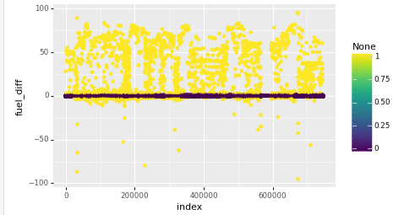
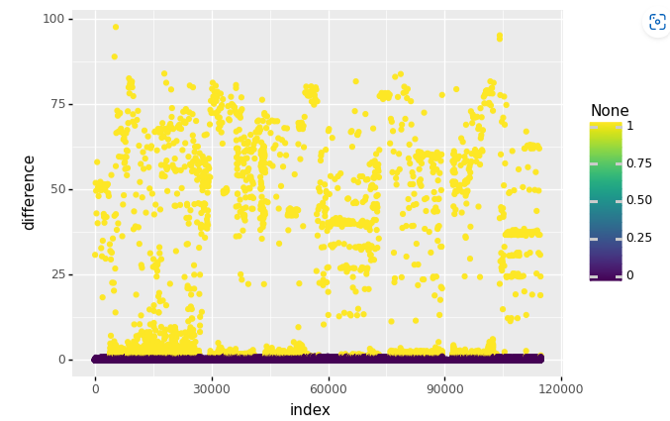
GMM result

Slide 19
Feature Selection
Spearman Correlation
Feature Importance
Kruskal Wallis Test

Slide 20

Label
XGBoost | Random Forest | LightBGM | Spearman Correlation
lat | lon | distance | distance
lon | lat | speed | speed
distance | axis Y | lat | axisZ
speed | timestamp | lon | heading
timestamp | distance | heading | gnnsHDOP
battery Voltage | heading | axis Y | altitude
altitude | axis Z | axis Z | axisY
heading | battery Voltage | timestamp | BTM
axis Y | axis X | altitude | BDM
axis Z | altitude | axis X | lon
gnssHDOP | speed | battery Voltage | gnnsPDOP
axis X | gnssPDOP | gnssPDOP | engine cc
Fuel Capacity | gnssHDOP | gnssHDOP | lat
BTM | BTM | Fuel Capacity | axisX
gnss PDOP | fuel capacity | BTM | battery voltage
Engine cc | BDM | BDM | Fuel capacity
BDM | Engine cc | Engine cc | timestamp

Slide 21
Feature selection
Speed
Battery Voltage
Altitude
Heading
Lat
Lon
Axis X
Axis Y
Axis Z
distance
timestamp
label

Slide 22

Modelling
LightGBM
Random Forest
XGBoost

Slide 23
Evaluation
Split data based on vehicles – 5 vehicles for testing and validation, the rest used for training
Metrics : R2, MAE, MSE and RMSE

Slide 24
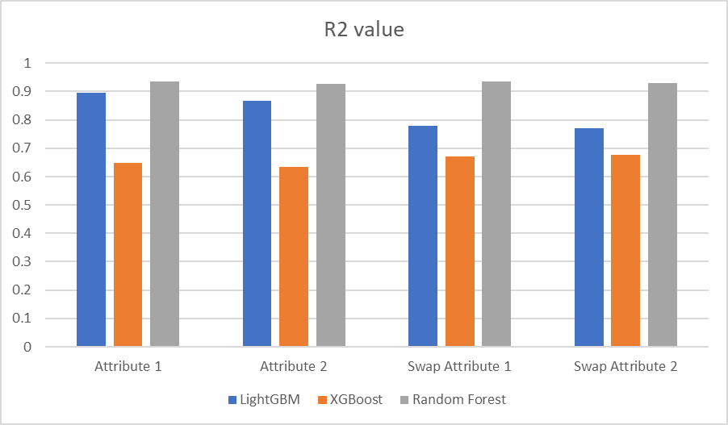
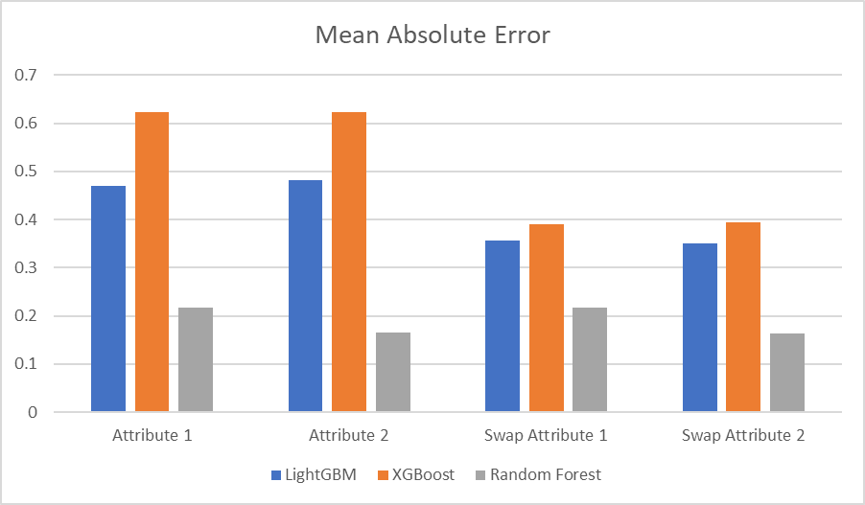
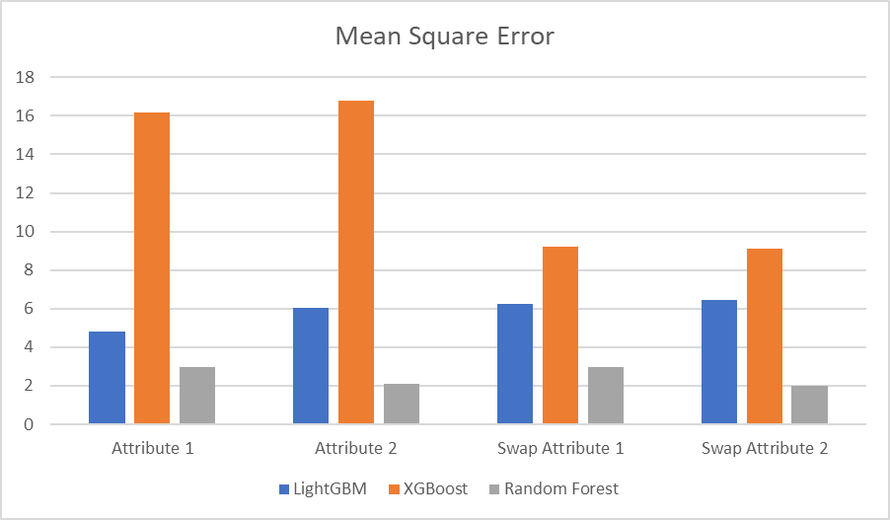
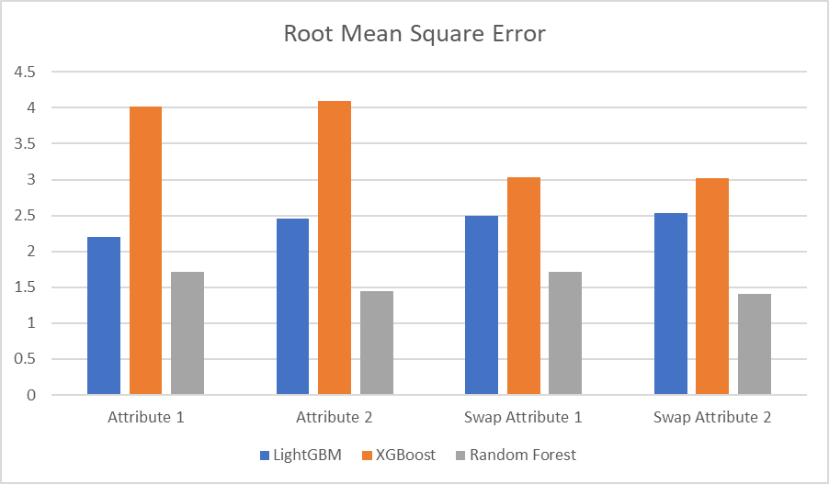

Slide 25
Why Random Forest?
Robust to noisy data
Reduction of overfitting
Handling non linear relationships
Robust to outlier
Minimal hyperparameter tuning

Slide 26

Contributions
Provides a data cleaning framework to OBD sensor data
showed that geographical data, driving behaviour, fuel activities, distance, speed and battery voltage are main factors
the capability of Random Forest in capturing complex relationship and non linear data.
provide a solid foundation for route optimization and carbon dioxide estimation

Slide 27

Future Works
Refinement of fuel consumption models
Integration with Smart Transportation Systems
Environmental Impact Assessment

Slide 28

Thank you

